Slide 1
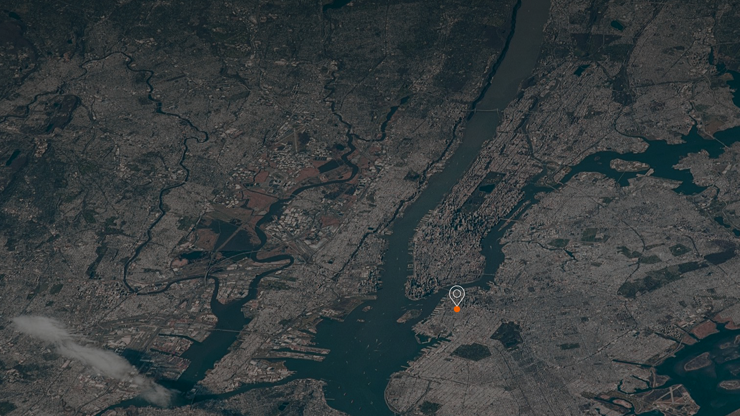
Borough-Based Jails
Boerum Hill Town Hall
January 23, 2023
Brooklyn Dismantle

Slide 2
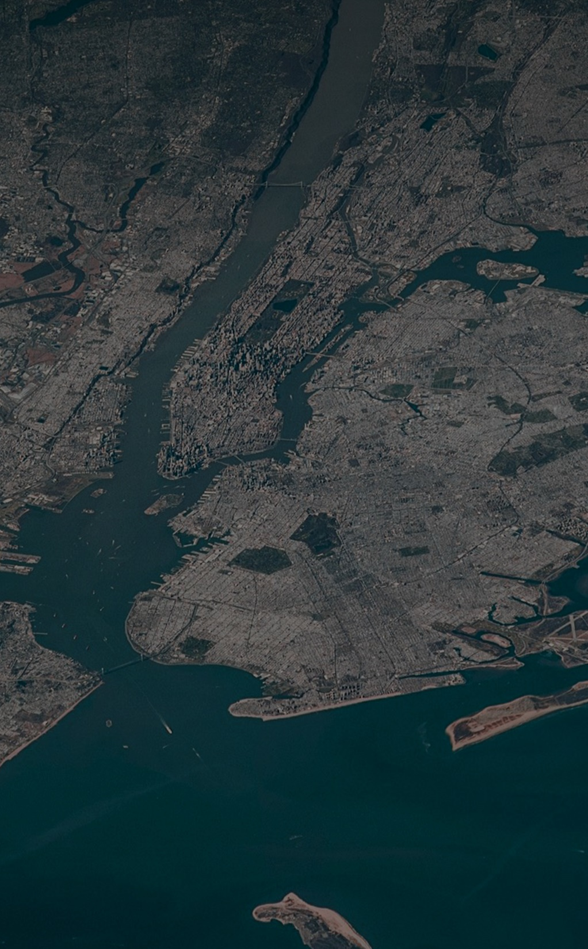
Interim Sally Port and Dismantle Updates
Environmental Monitoring​
Community Engagement and Resources
Q&A
1
2
Agenda
3
4
March 5, 2020

Slide 3
Brooklyn
Interim Sally Port and Dismantle Updates

Slide 4
Project Schedule Milestones
Milestone | Estimated Dates
Site Assessment and Surveys (Verification of existing building conditions) | Complete
Mobilization / Site Fencing Site fencing, sidewalk shed installation, field office South Sidewalk Closure on State Street March 2022 (Pedestrian circulation will be maintained) | Complete
Interim Sally Port and Officer Booth Construction | April 2022 – January 2023
Dismantle Work - Oil Tank removal on the north side of State Street, remove and install new tanks (Winter 2022 – Summer 2023) -Temporary Sidewalk and Parking restrictions expected on Smith and State St. | January 2023– July 2023
Podium Dismantle - Removal of 1-2 story structure bordering Boerum Pl, Atlantic Ave., & Smith St. | October 2022 – January 2023
*Estimated Dates and Milestones will be updated by Design-Builder
INFORMATIONAL PURPOSES ONLY

Slide 5
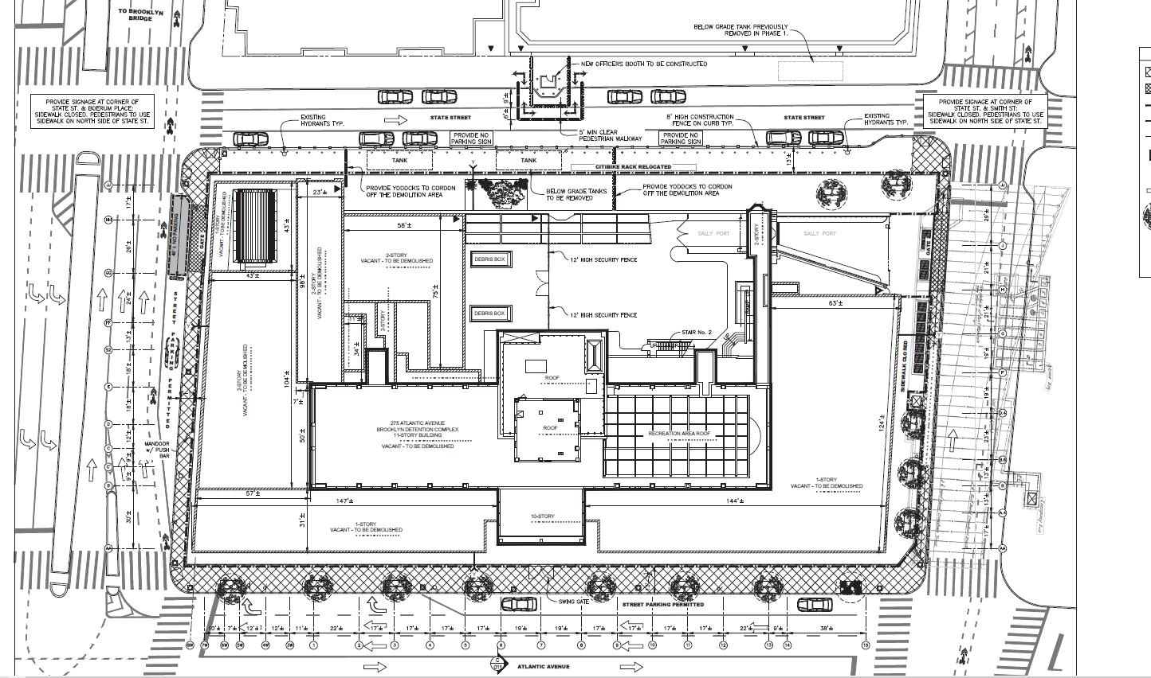
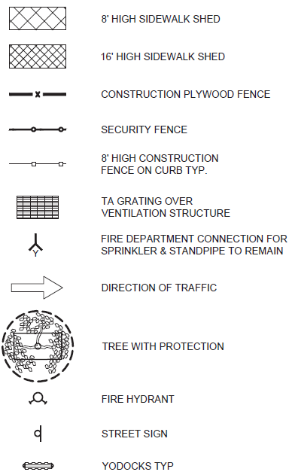
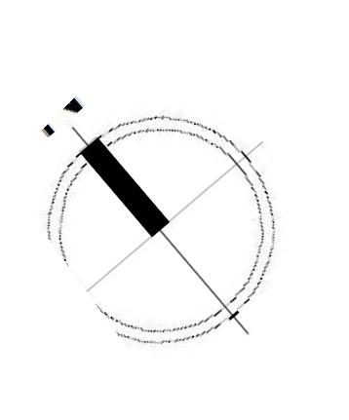
Overview of Dismantle Activities & Progress
Prep site for tank excavation
Interim sally port and officer booth
State St
Trailer
Offices
Deliveries and Subcontractor Staging Area
Trailer Offices
Podium dismantle progress
Hoist installation
Smith Street
Boerum Pl
Sidewalk Closure
MTA Vent Shafts
Oil tank removal
Atlantic Ave
Roof bulkhead & yard scaffolding
Oil tank Installation
275 Atlantic Ave.
Notes:
DB Team

Slide 6
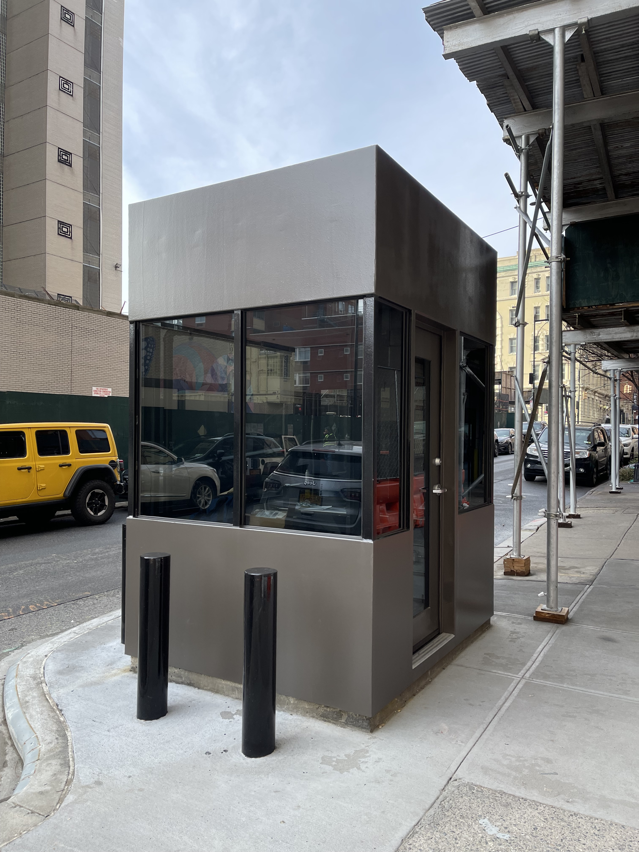
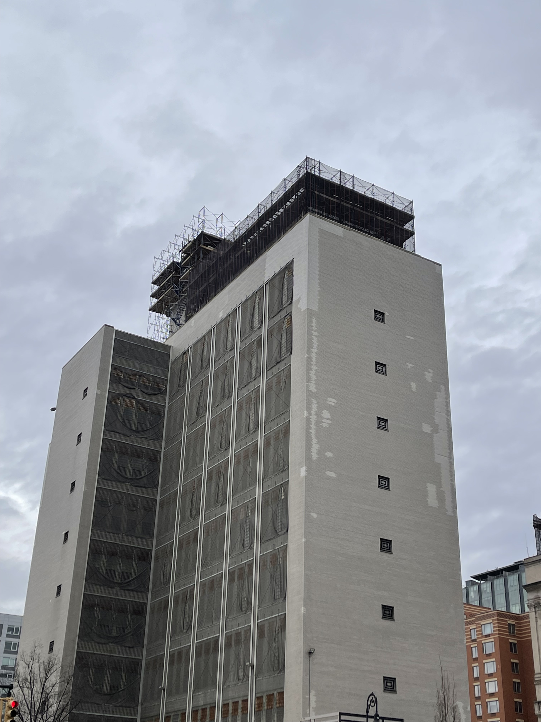
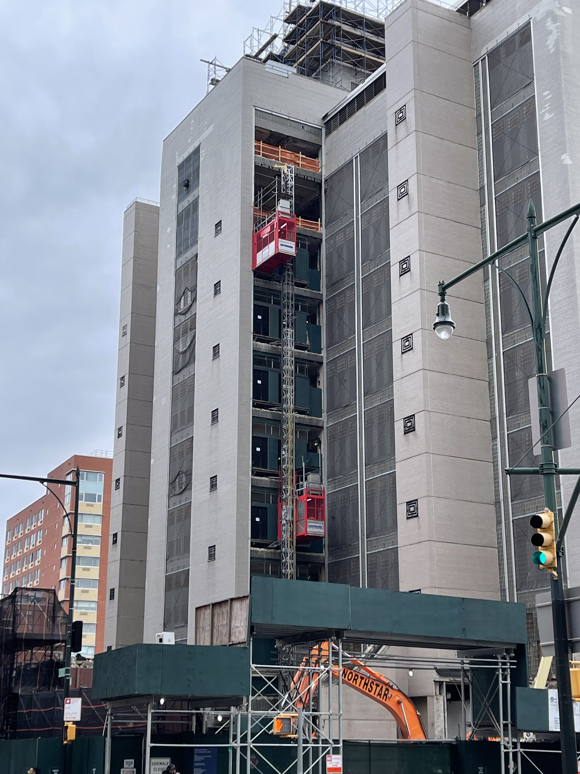
Dismantle Progress Photos
Completed
Officer Booth
1/13/23
Tower scaffolding around bulkhead and yard
1/13/23
Tower hoist construction
and operation
1/13/23
Notes:
DB Team

Slide 7
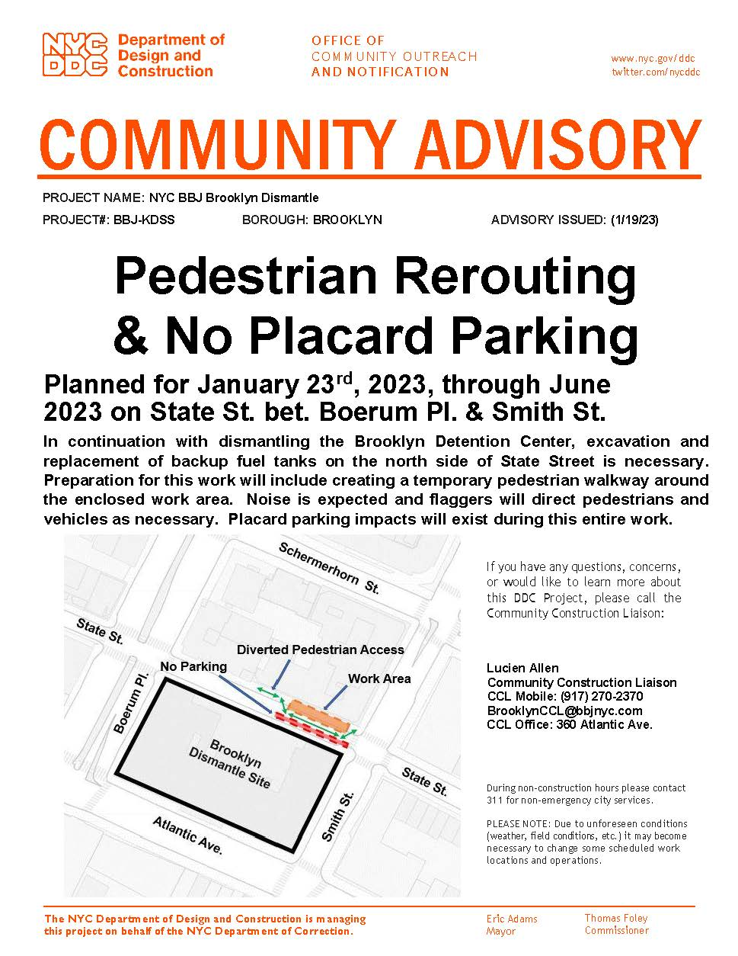
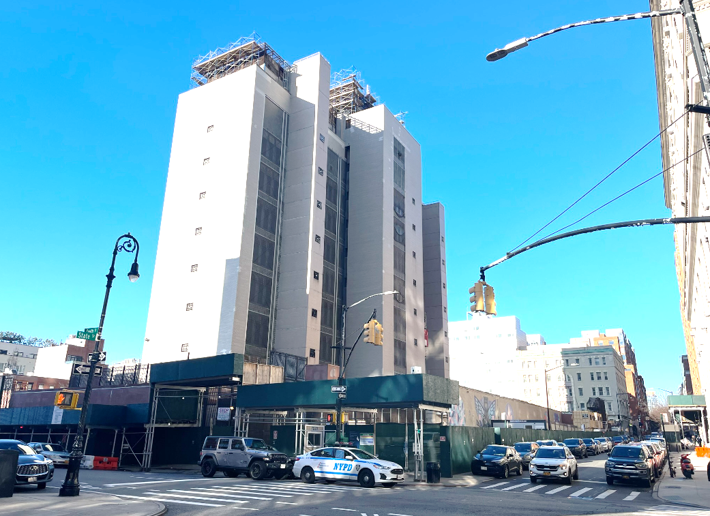
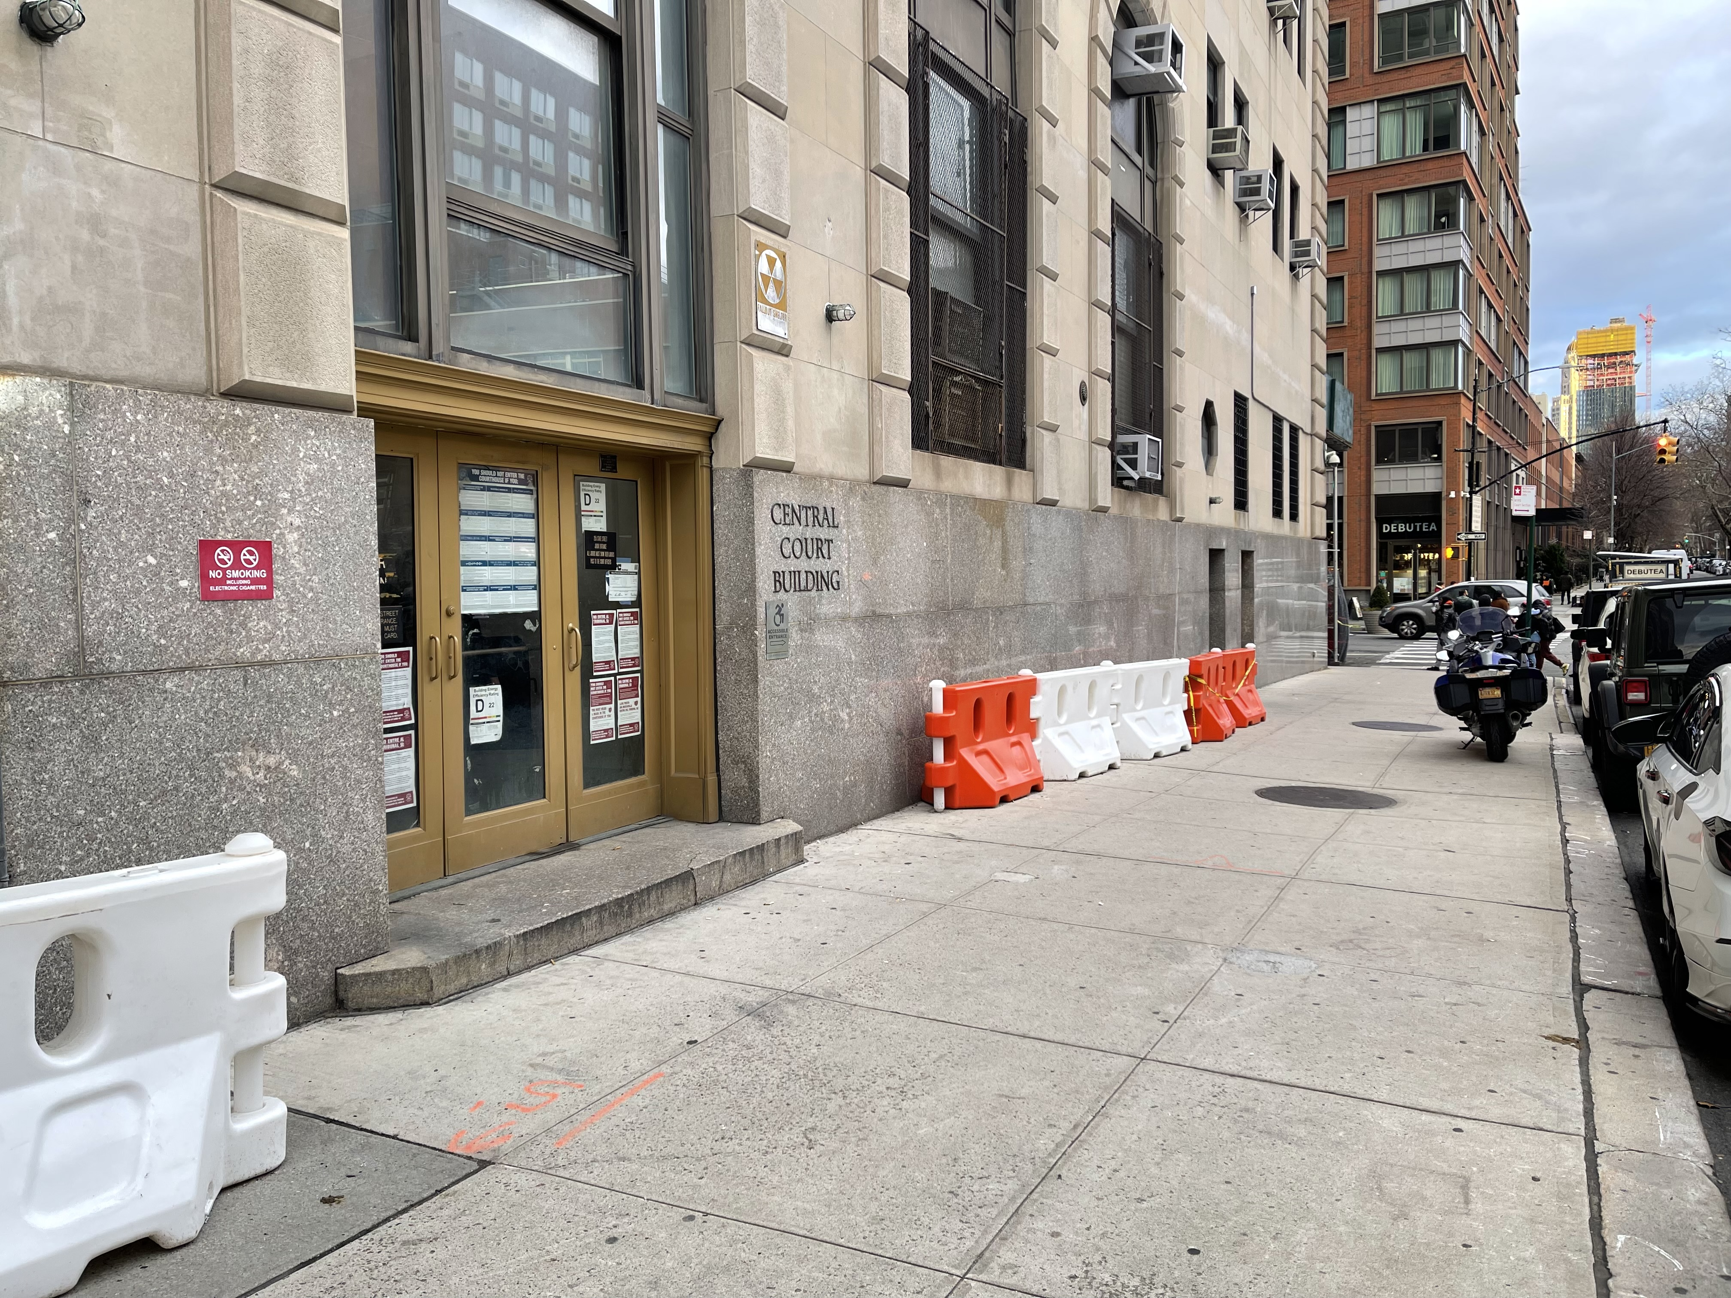
Active Advisory Notice
Pedestrian Rerouting & No Placard Parking on State St. expected to start next Monday 1/23 through June 2023

Slide 8
Brooklyn
Environmental Monitoring

Slide 9
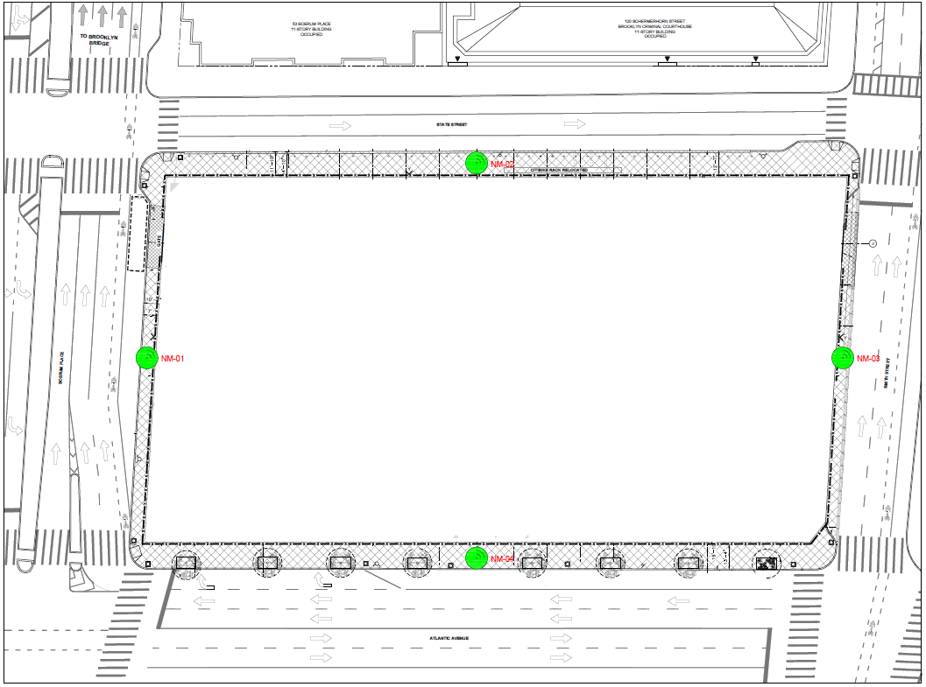
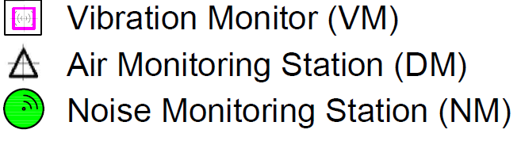
Environmental Monitoring Updates
The BBJ team will provide quarterly environmental monitoring updates at Community Board and Neighborhood Advisory Committee (NAC) meetings.
The environmental monitoring reports and environmental factsheets are posted on the BBJ website: https://rikers.cityofnewyork.us/environmental-monitoring-reports/
Vibration Monitoring: (PSI Agency, Inc.)
Monitor 1 is placed within 120 Schermerhorn Street (Court Building).
Monitors are placed within the F train subway tunnel under Smith Street.
Baseline data collection was taken in April 2022.
Noise Monitoring: (PSI Agency, Inc.)
4 Monitors are at the sidewalk bridge locations at the center of Smith Street, Atlantic Avenue, Boerum Place, and State Street.
Noise monitoring is being performed on a continuous basis.
Air Quality Monitoring: (PSI Agency, Inc.)
4 particulate monitoring stations are at each corner of the site. Particulate monitoring is performed daily at 15-minute intervals.
The Action Level is set below the Permissible Exposure Levels (PEL) . When Action Levels are reached, the construction activities are assessed, and the contractor immediately acts to apply steps to control dust and emissions before the PEL is reached.
The BBJ Construction Management Team, Project Contractors and Environmental Specialists receive real time alerts when Particulate Matter (PM), decibels (dBa), or velocity of vibration (ips) number approach and Action Level.
State St
Boerum Pl
Smith Street
Atlantic Ave
Vibration, Air and Noise monitoring devices installed by Design-Build team.
Notes:
DB Team

Slide 10
Environmental Monitoring Updates
DECEMBER 2022 & JANUARY 2023 | NOVEMBER & DECEMBER 2022
Air Quality Monitoring | In December 2022 and January 2023, construction‐related levels of Particulate Matter (PM) PM10 did not surpass Daily Permissible Exposure Limits (PEL) as set by federal standards for the 24‐hour Time Weighted Average (TWA), or daily value, and did not cause air quality concerns to the public or on‐site workers.
Noise Monitoring | In December 2022 and January 2023, construction-related levels of noise did not surpass the limits of Local Law 113 and did not cause noise concerns for the community. No corrective actions or mitigation measures were required.
Vibration Monitoring | In December 2022 and January 2023 , no alarm was triggered during or by any construction activity. No corrective actions or mitigation measures were required.
*No exceedances are expected for the remainder of January. Levels will be continuously monitored, and corrective actions will be taken if necessary*
Monthly reports will be posted online: https://rikers.cityofnewyork.us/environmental-monitoring-reports/
Notes:
DB Team

Slide 11
Brooklyn
Community Engagement and Resources

Slide 12
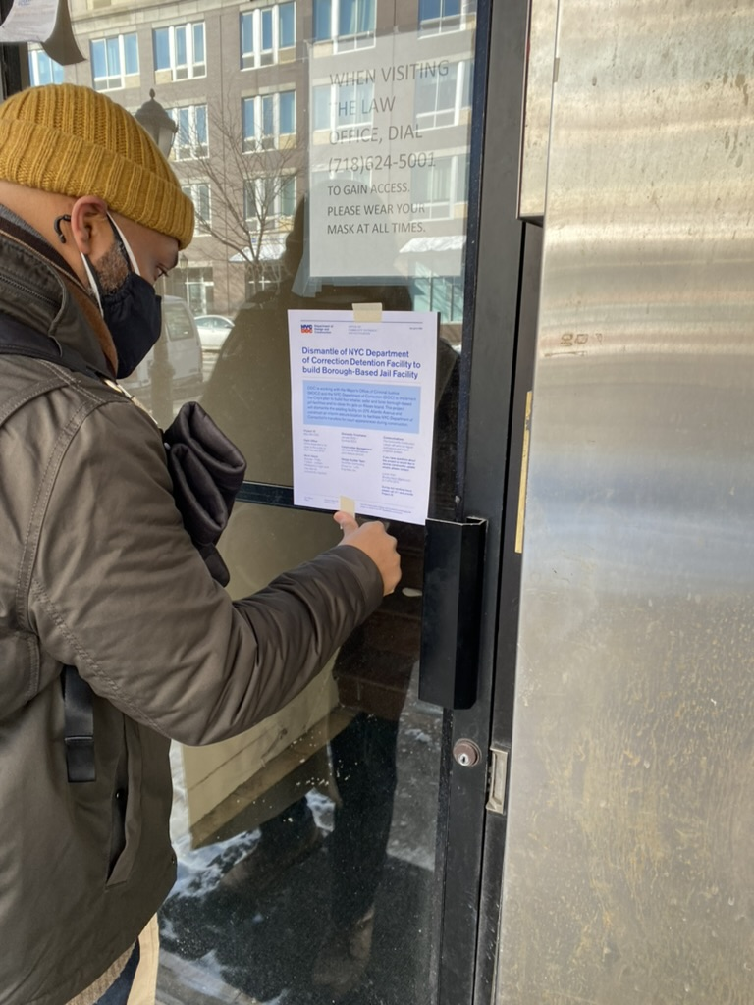
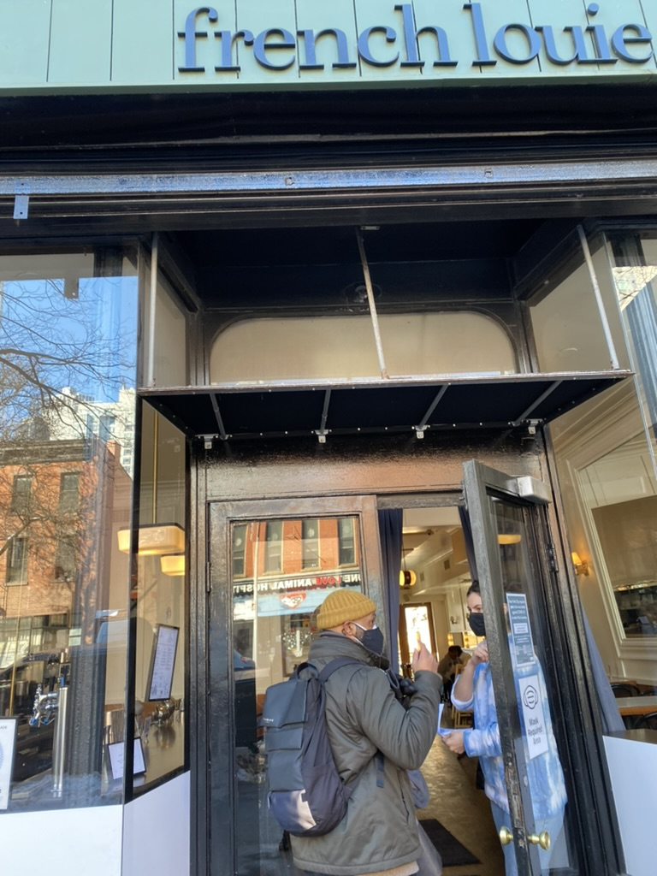
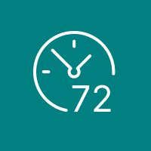
Community Resources During Construction
Community Construction Liaison & Field Office
BBJ Website
https://rikers.cityofnewyork.us/
Lucien Allen Brooklyn BBJ CCL
(917) 270-2370 / BrooklynCCL@bbjnyc.com
360 Atlantic Avenue
Monday – Friday 7:00am - 3:30pm
Designated Phone Number
Weekly Look Ahead
72-Hour Advisories for Impactful Construction Activities

Slide 13
Brooklyn
Q & A

Slide 14
Borough-Based Jails | NAC
Thank You
Brooklyn Dismantle

